Slide 1
11-785: Recitation 8 (Spring 22)
RNN Basics
Aparajith, Soumya, Shreyas, Lavanya

Slide 2
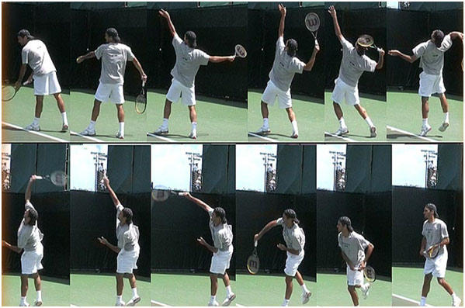
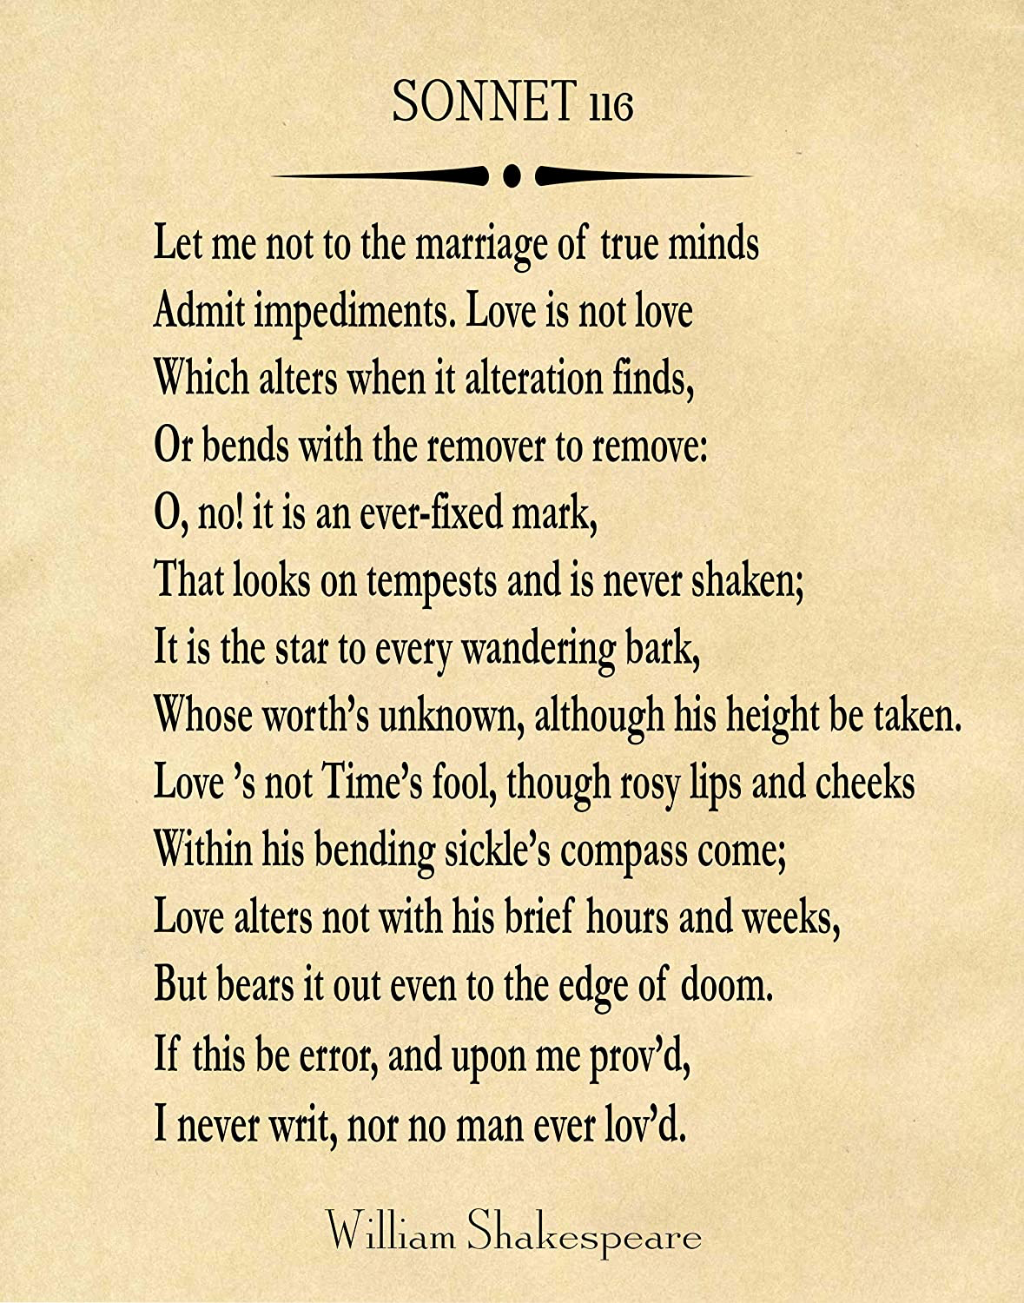
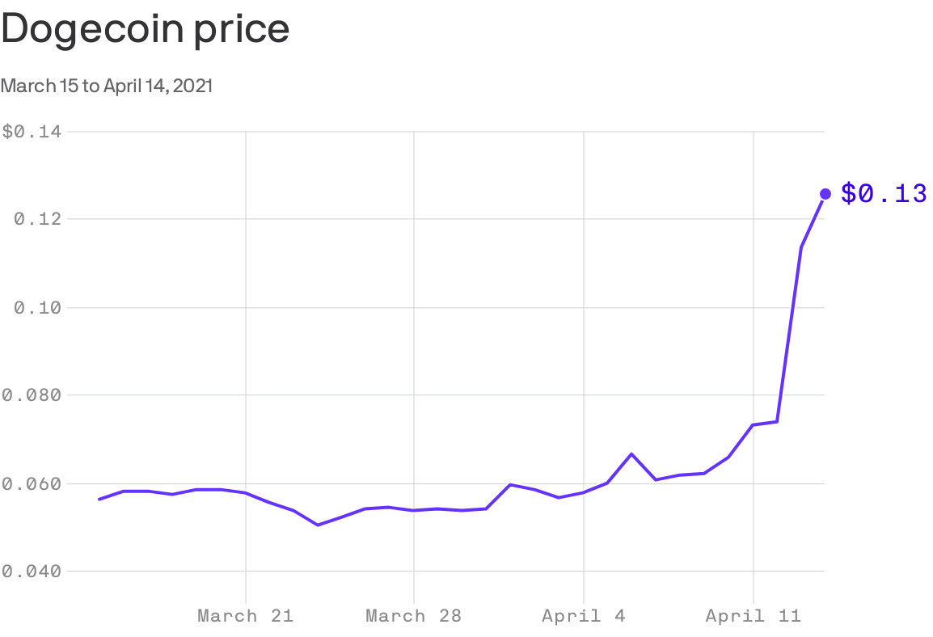
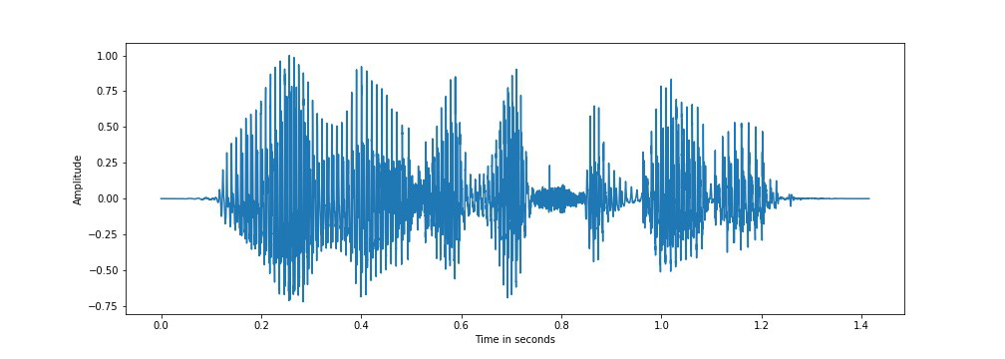
Sequential Data
Data from which various inputs are dependent
Examples:
Text: “Hi. How are you doing today?”
Audio/speech
Video
Any other time series data like stock price, daily temperature, etc.
Reference: Audio, Stock, Text, Video

Slide 3
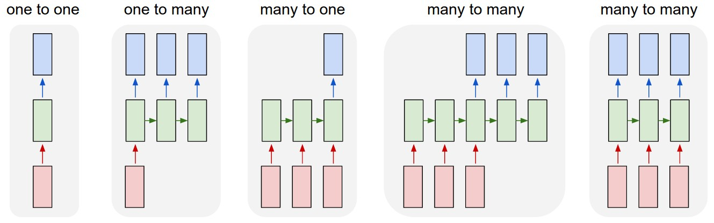
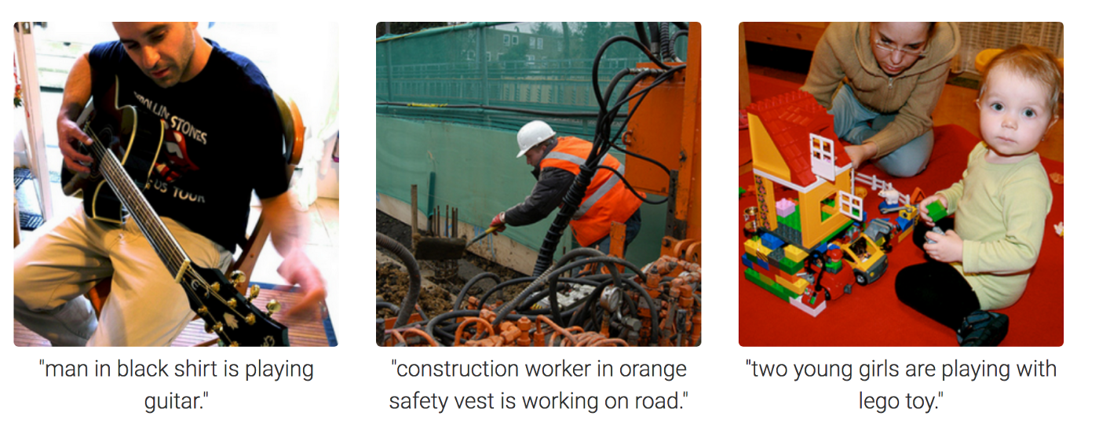
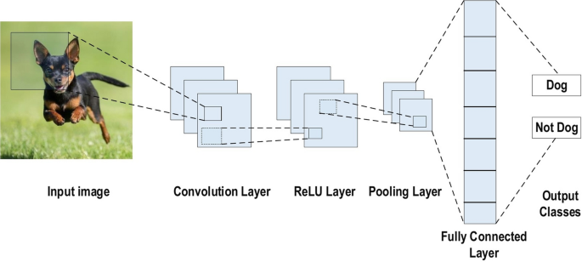
Data Modeling
Image Classification (ref)
Image Captioning (ref)
(https://i.stack.imgur.com/b4sus.jpg)

Slide 4
Data Modeling
Sentiment Analysis (Movie Review)
The Batman (2022) is everything a superhero movie should be. (Positive)
Machine Translation
“How are you?” -> “எப்படி இருக்கிறீர்கள்?"
Object Tracking in videos
Video

Slide 5
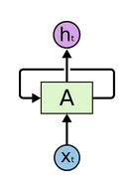
Recurrent Neural Networks
Looping network
Parameter sharing across timesteps
Derivatives aggregated across all time steps
“Backpropagation through time (BPTT)”
(http://colah.github.io/posts/2015-08-Understanding-LSTMs/)

Slide 6
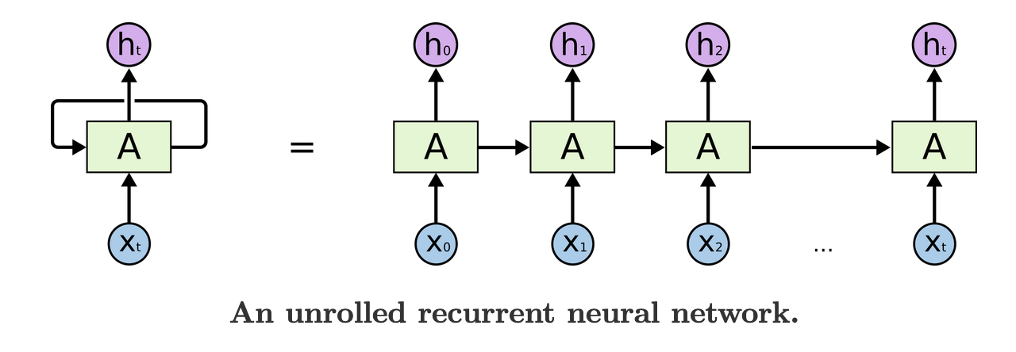
RNN Unrolled
h-1
(http://colah.github.io/posts/2015-08-Understanding-LSTMs/)

Slide 7
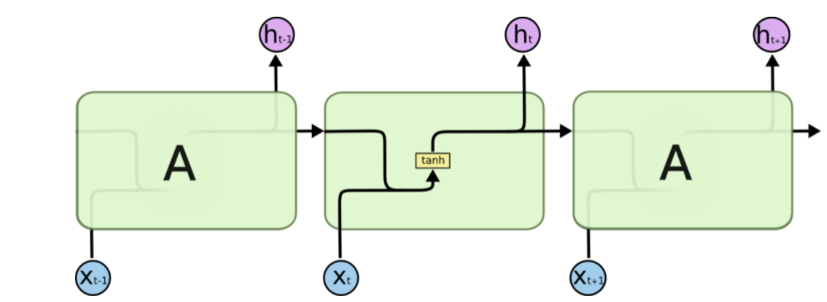
Problems with RNN
Short term memory
Exploding gradients
Vanishing gradients
Factors governing the retention of memory in RNN:
Weights of the recurrent layers
Bias of the recurrent layers
Activation function used in recurrent layers

Slide 8
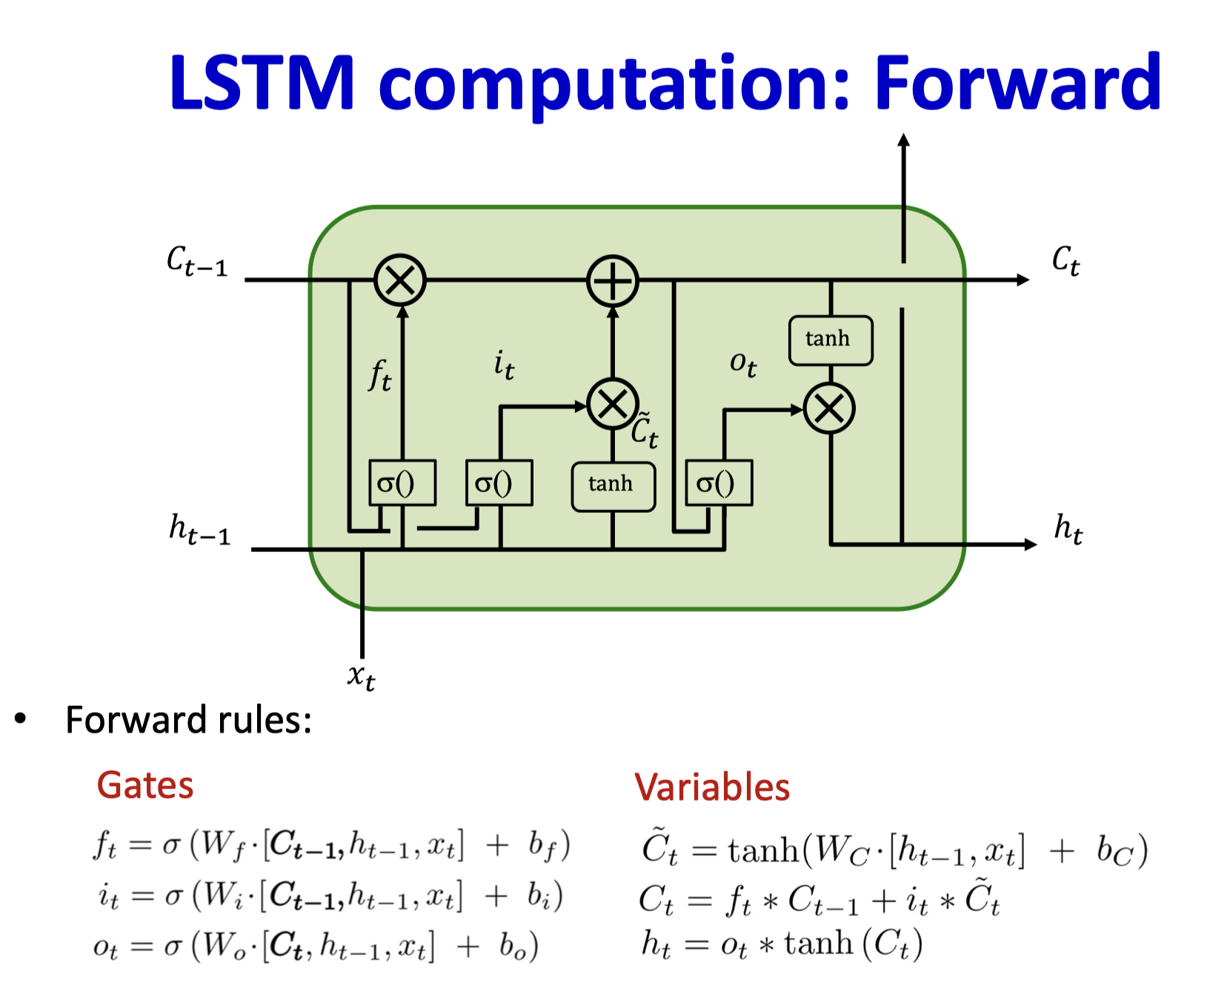
LSTM Cell ( Variation 1)
(Gers and Schmidhuber 2000: Recurrent Nets that Time and Count)

Slide 9
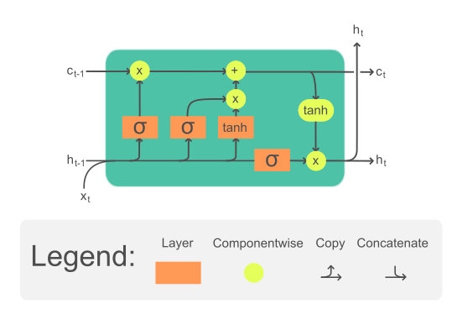
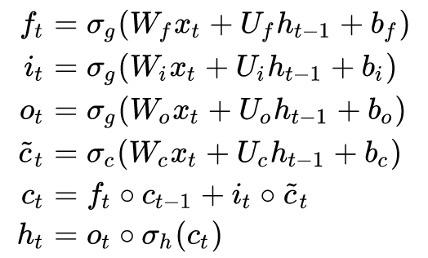
LSTM Cell ( Variation 2 )
Key components: Cell state, Forget gate, Input gate and output gate

Slide 10
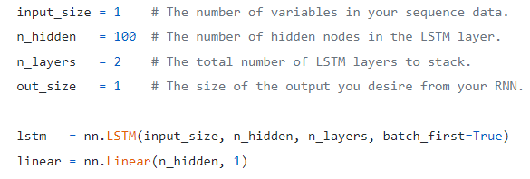
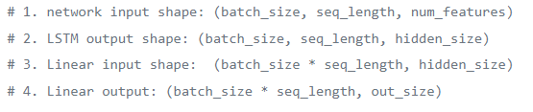
Torch example to understand parameters and shapes
Input output shapes
https://towardsdatascience.com/lstms-in-pytorch-528b0440244

Slide 11
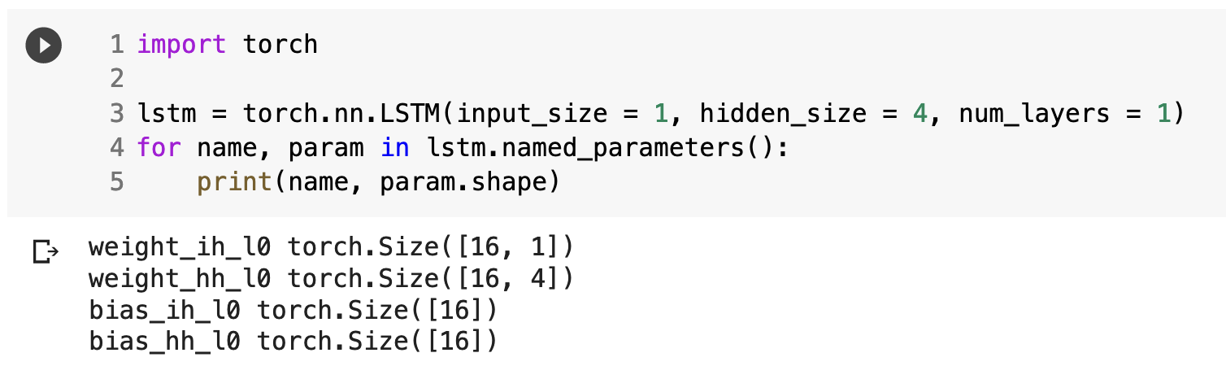
Caution in PyTorch Implementation
Questions:
What are weight_ih and weight_hh?
How to interpret the dimensions?
Which version of LSTM is this?
How should you use initialization (e.g. Xavier, Kaiming)?

Slide 12
Caution in PyTorch Implementation
Questions:
What are weight_ih and weight_hh? Input weights and hidden weights
How to interpret the dimensions? Input, forget, cell, and output weights stacked (reference)
Which version of LSTM is this? Wikipedia version (no peephole connection)
How should you use initialization (e.g. Xavier, Kaiming)? We initialize each one of four (three if GRU) matrices separately

Slide 13
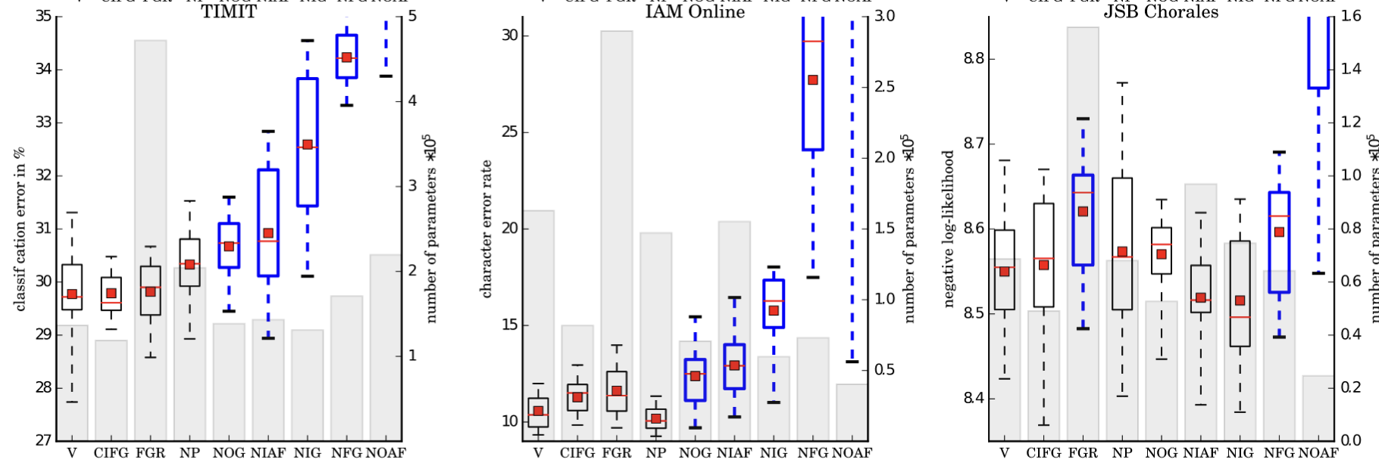
Performance per LSTM Component
(Greff et al. 2017: LSTM: A Search Space Odyssey)
CIFG: GRU, NP: No peepholes, FGR: Full gate recurrence, NOG: No output gate, NIG: No input gate, NFG: No forget gate, NIAF: No input activation function, NOAF: No output activation function)

Slide 14
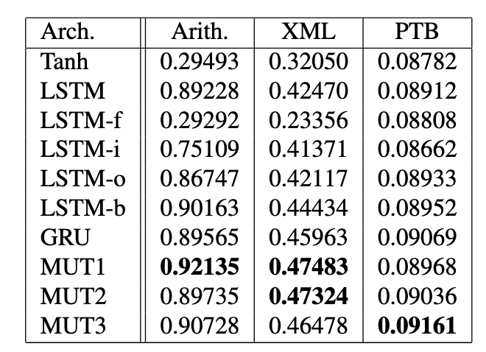
Performance per LSTM Component
(Jozefowicz et al. 2015: An Empirical Exploration of Recurrent Network Architectures)

Slide 15
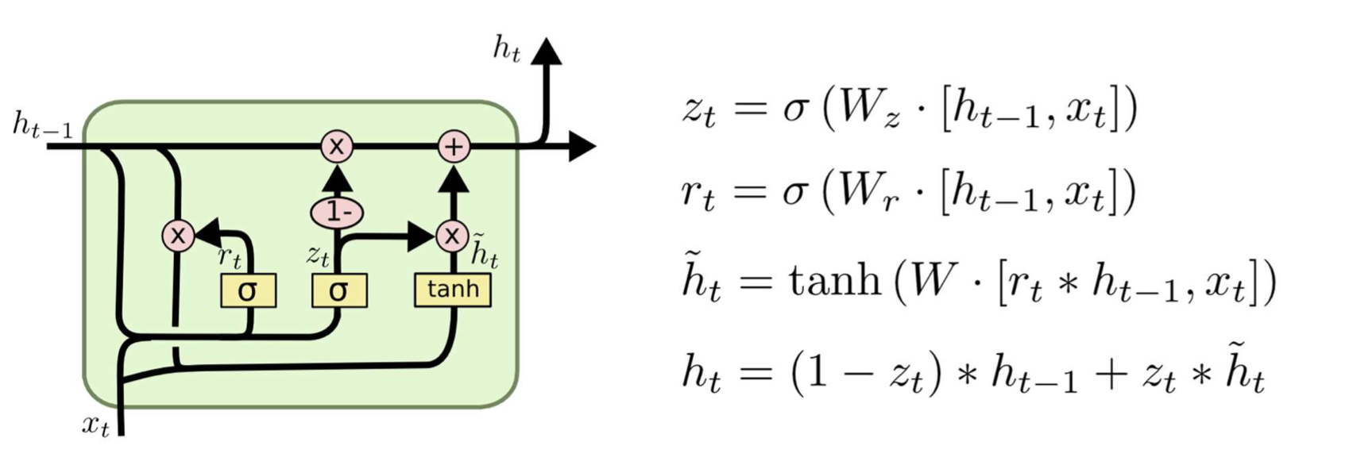
GRU Cell
GRUs can’t count! (Weiss et al. 2018: On the Practical Computational Power of Finite Precision RNNs for Language Recognition)

Slide 16
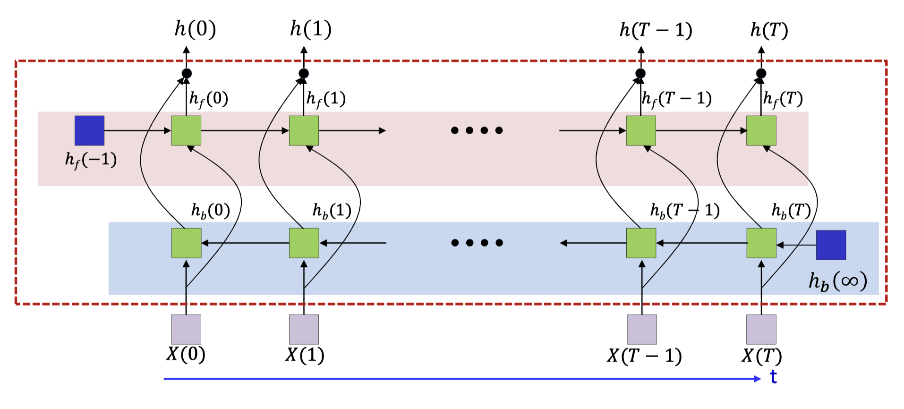
Bidirectional RNN

Slide 17
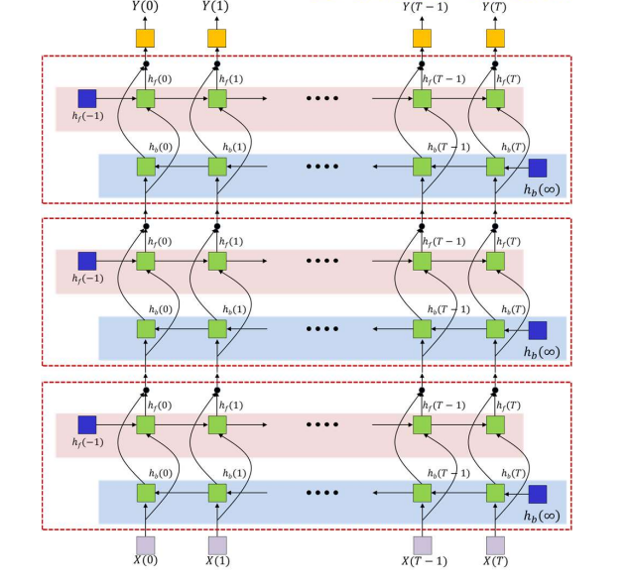
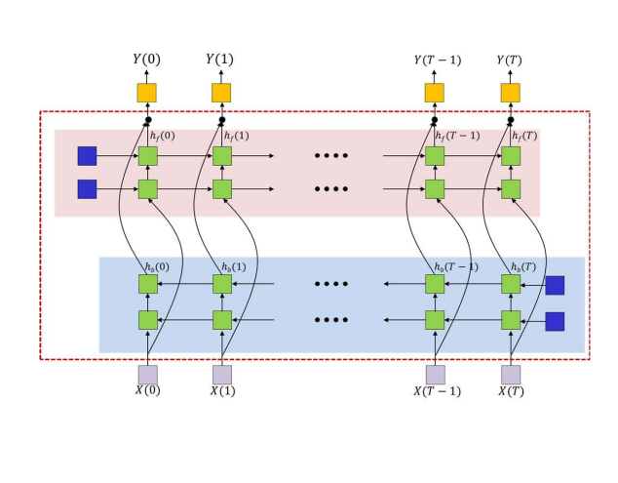
Actual Network with BRNNs:

